Slide 1
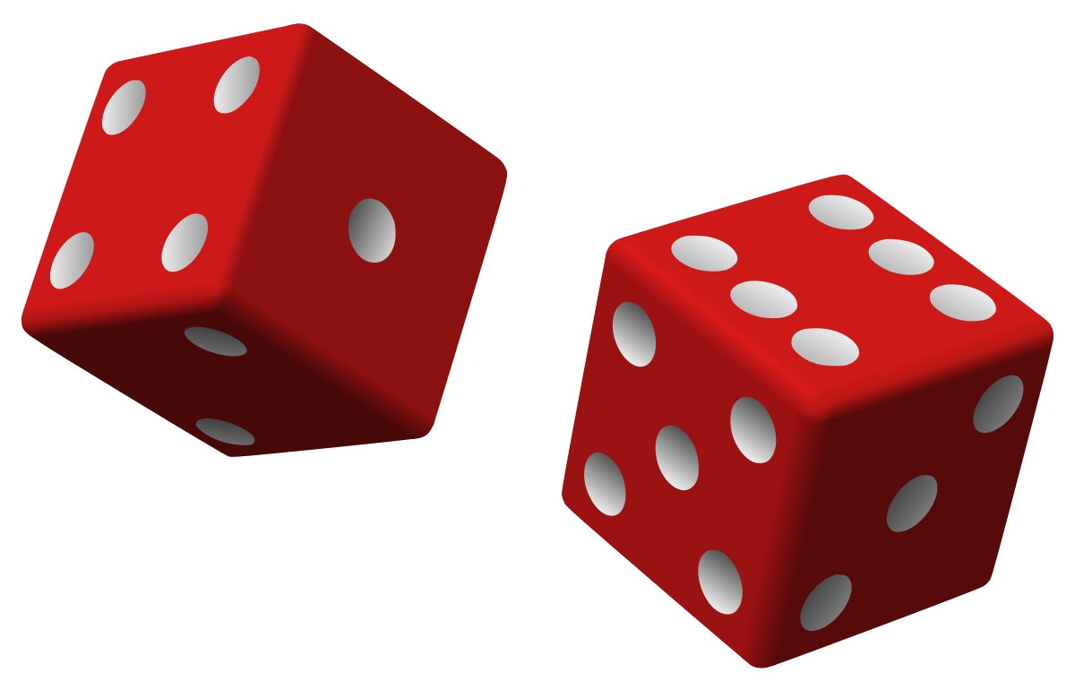
Random Numbers
CSC 221

Slide 2
Random Numbers
A random number is a value chosen unpredictably and without a pattern, like picking a number out of a hat.
Computers usually generate random numbers using algorithms.
These algorithms rely on an initial value, called a "seed."
By applying mathematical formulas to this seed, they produce a sequence of numbers that appear random.
It's like turning a crank on a machine that spits out seemingly random numbers, even though the process is actually quite systematic.

Slide 3
How Random Numbers Are Used
Random numbers are useful for lots of different programming tasks such as:
Computer games that let the player roll dice use random numbers to represent the values of the dice.
Programs that show cards being drawn from a shuffled deck use random numbers to represent the face values of the cards.
In simulation programs where the computer must randomly decide how a person, animal, insect, or other living being will behave.
In statistical programs that must randomly select data for analysis.
In computer security to encrypt sensitive data.
To use these capabilities, you will need the following precompiler directive:
#include <random>

Slide 4
Random Number Objects
To generate random numbers, you will need to define two objects in your program:
A random number engine
A distribution object
The random number engine generates a sequence of random bits.
The distribution object reads the random bits that are generated by the random number engine and produces random numbers of a specified data type, within a specified range.

Slide 5
The Random Number Engine
The C++ library provides several random number engines that you can use, depending on the needs of your application.
The on we will use is the random_device engine, which is adequate for most applications.
Here is an example of how you define a random_device engine named myEngine:
random_device myEngine;

Slide 6
The Distribution Object
This statement declares a uniform_int_distribution object to generate random integers between 0 and 100:
uniform_int_distribution<int> randomInt(0, 100);
You can specify any of the C++ integer types (short, int, long, etc.).
This statement will define a distribution object that generates random floating-point numbers between 0.0 and 1.0:
uniform_real_distribution<double> randomReal(0.0, 1.0);

Slide 7
Generating a Random Number
Assuming we have defined a random number engine named myEngine and a distribution object named randomReal, the following statement will generate a random floating-point number and assign it to the number variable:
double number = randomReal(myEngine);

Slide 8
Program 3-25
1 // This program simulates rolling dice.
2 #include <iostream>
3 #include <random>
4 using namespace std;
5
6 int main()
7 {
8 // Constants
9 const int MIN = 1; // Minimum dice value
10 const int MAX = 6; // Maximum dice value
11
12 // Random number engine
13 random_device engine;
14
15 // Distribution object
16 uniform_int_distribution<int> diceValue(MIN, MAX);
17
18 cout << "Rolling the dice...\n";
19 cout << diceValue(engine) << endl;
20 cout << diceValue(engine) << endl;
21 return 0;
22 }
Program using random numbers to simulate rolling dice.
Three Examples of Program Output
Rolling the dice...
5
2
Rolling the dice...
4
6
Rolling the dice...
3
1

